Slide 1

Gain & Grain
Ethan Crall
Trevor Eisenbacher
Viwesh Gupta
Brodie Kovach
Peyton Pridemore

Slide 2

Registration Page

Slide 3

Forgot Password

Slide 4
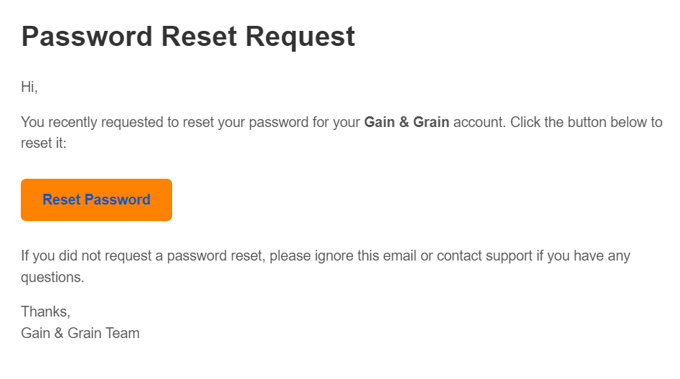
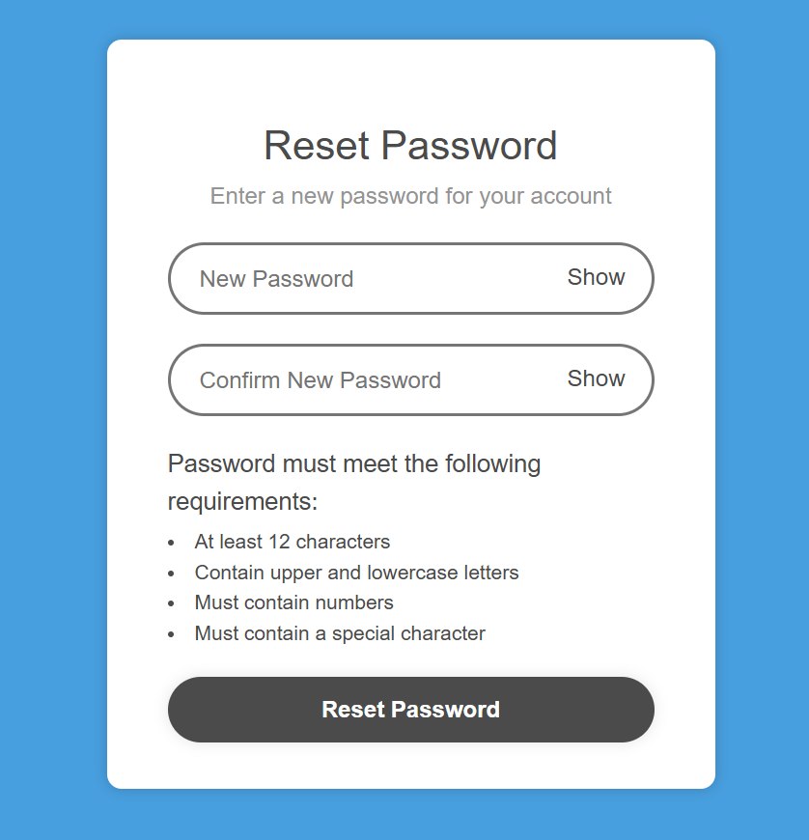
Reset Password

Slide 5



Tools

